Slide 1
Syncd-ot Source code and architecture overview
Weitang Zheng@Alibaba

Slide 2
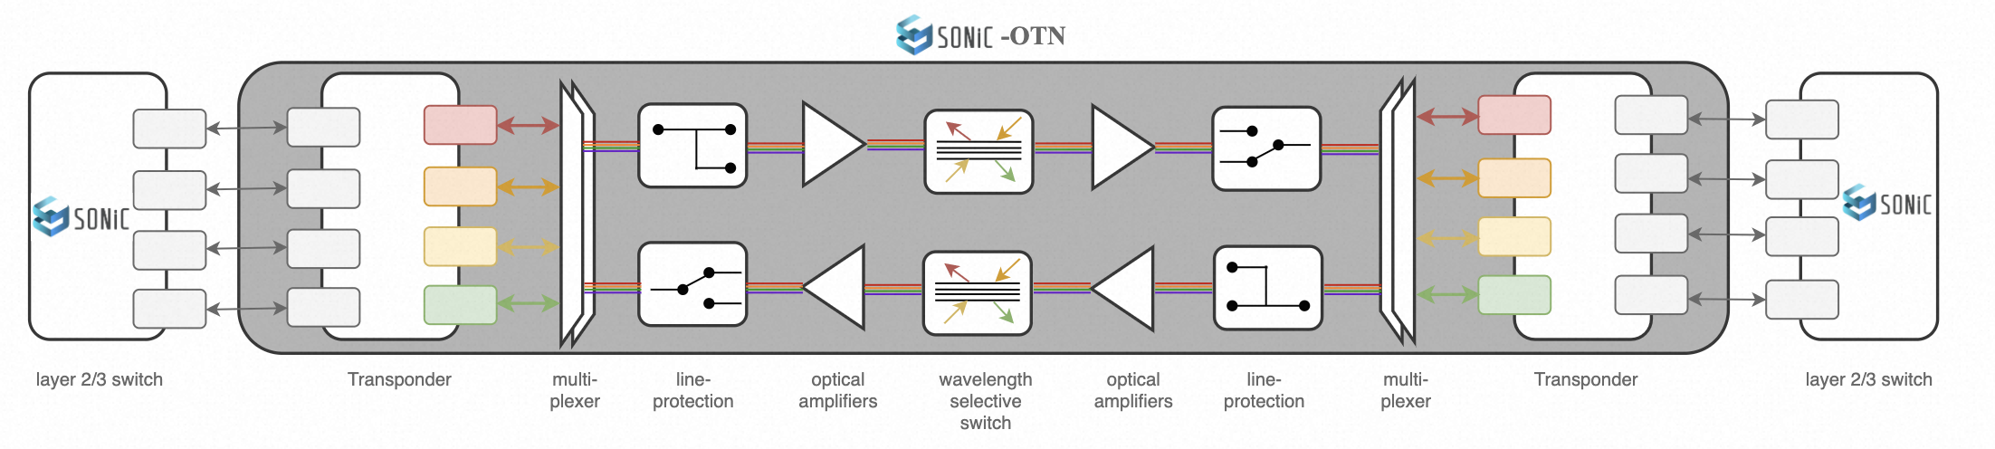
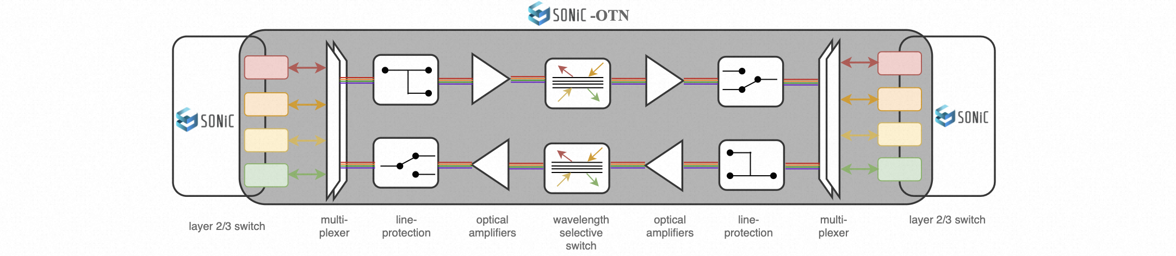
Workgroup Chart
Enabling SONiC to support optical transport equipment
Optical transponders/muxponders
Optical line equipment, optical amplifiers, wavelength selective switches
Optical DWDM/Grey pluggable modules on switching/routing equipment

Slide 3

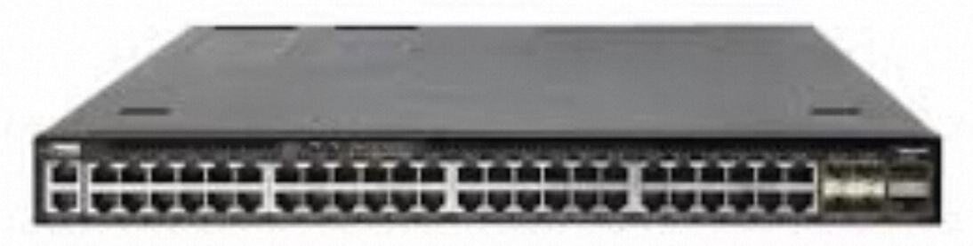
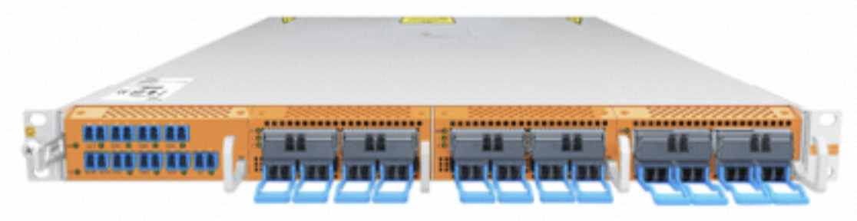
SONiC Deliverables
Switch/Router/...
make configure PLATFORM=[ASIC_VENDOR] PLATFORM_ARCH=arm64
ASIC_VENDOR in [barefoot, broadcom, marvell, mellanox, ..., vs]
make target/sonic-ASIC_VENDOR.bin
Optical Transport Device
make configure PLATFORM=[OTN_VENDOR] PLATFORM_ARCH=arm64
OTN_VENDOR in [ot-accelink, ot-molex, ot-infinera, ot-vs]
make target/sonic-OTN_VENDOR.bin

Slide 4
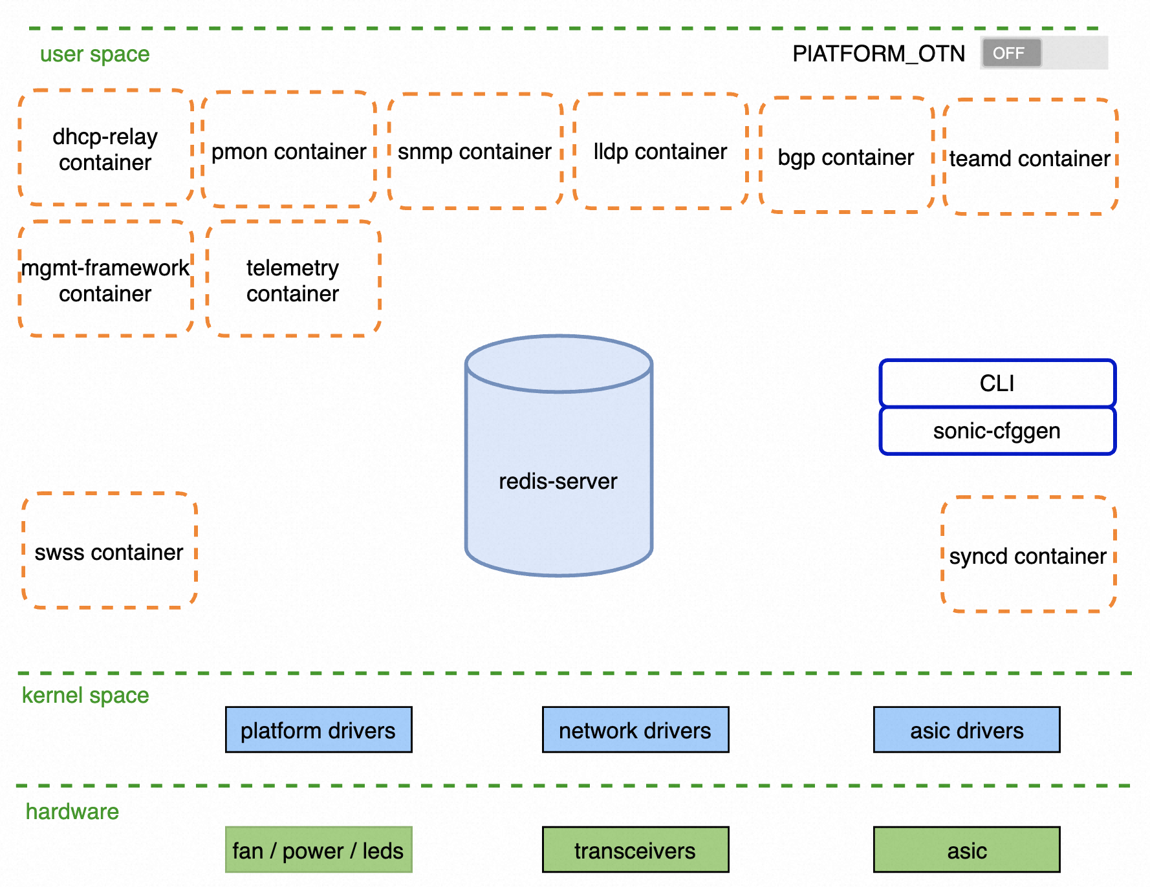
SONiC Architecture
make configure PLATFORM=[ASIC_VENDOR]
OTN features are disabled by default
Native SONiC for Switch and Router

Slide 5
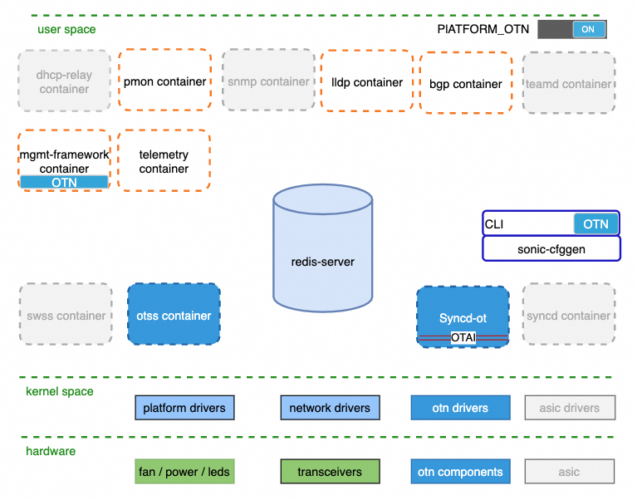

SONiC for pure OTN Device
make configure PLATFORM=[OTN_VENDOR]
OTN Feature Toggle:
files/build_templates/init_cfg.json.j2
OTN features and enhancement are Enabled
Some SONiC IP features are disabled

Slide 6
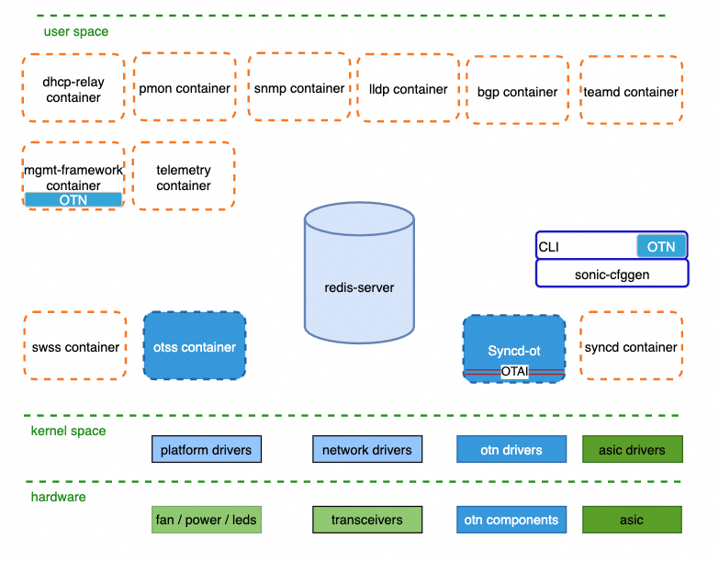
SONiC for IP over OTN Device
make configure PLATFORM=[ASIC_VENDOR]
Native SONiC for Switch and Router
OTN features are enabled by feature toggle
OTN Feature Toggle:
files/build_templates/init_cfg.json.j2

Slide 7
Why deploy OTN feature as SONiC service
Reduce risks
IP and OTN service is isolated in docker, any failure will NOT impact the other
Team capability
Developers focus on a specific microservice, no cross domain knowledge required
Innovate faster
OTSS
Innovated on certain components more quickly and independently, easier for code review,
testing and deployment
Syncd-ot
OTAI library
OA
VOA
OLP
OCM
MUX
OTDR
OSC
WSS
Transceivers

Slide 8
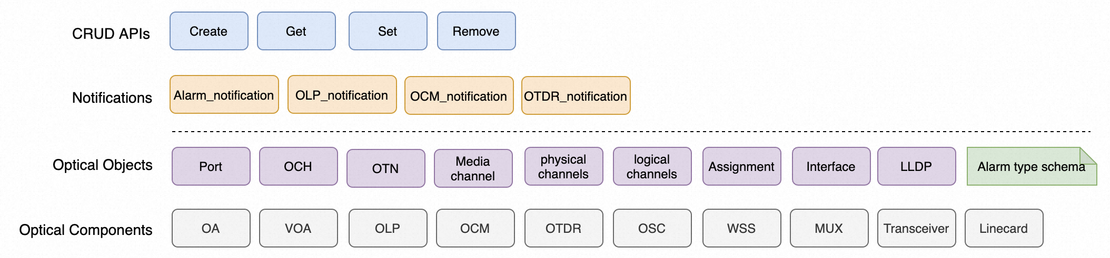
OTAI
https://github.com/sonic-otn/OTAI/tree/main/inc
Optical Transport Abstraction Interface (OTAI) provides standard APIs to manage Optical transport components.
CRUD APIs for all OTN components and objects
Notifications for OTN status change and data reporting
All Optical objects and components
Compatible with OpenConfig

Slide 9
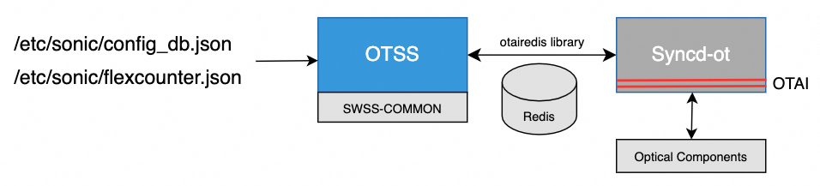
OTSS (Optical Transport State Service)
OTSS provides a database interface manage and state representation of optical transport component.
Repository: https://github.com/sonic-otn/sonic-otss
HLD: https://github.com/sonic-otn/SONiC/blob/master/doc/otn/otn_otss_hld.md

Slide 10
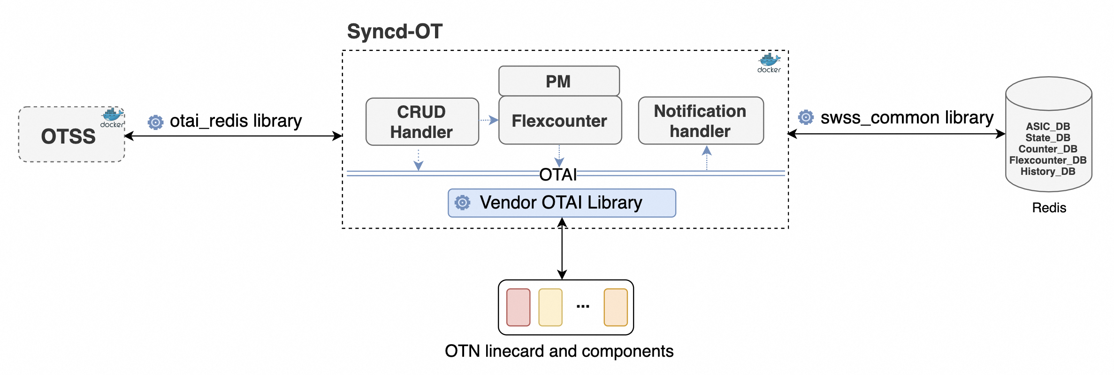
Syncd-ot (Syncd for optical transport)
Syncd-ot provides a lightweight synchronization mechanism with optical transport components.
Repository: https://github.com/sonic-otn/sonic-otairedis
HLD: https://github.com/sonic-otn/SONiC/blob/master/doc/otn/otn_syncd_hld.md

Slide 11
Can Syncd-ot share Syncd source code?
Yes and No. Syncd-ot can share some database infrastructure source code.
Syncd-ot has the same architecture framework, but with different domain context，terms and features.
Prefer pure and lean OTN implementation and without any cross IP domain reference.
sonic-sairedis
Syncd
SaiRedis
proxylib
pyext
saisdkdump
saiplayer
saidump
sonic-otairedis
saidiscovery
saiasiccmp
Syncd-ot
OtaiRedis
SAI meta data
otai meta data
SAI
OTAI
Port
ACL
STP
QOS
VLAN
IPMC
OA
VOA
OLP
OCM
MUX
TUNNEL
L2MC
SRV6
OTDR
OSC
WSS
Transceivers
ROUTE
TAM
DTEL
BFD
NAT
IPSEC
POE
ICMP
MECSEC
……
93K lines of c++ source code
10K lines of c++ source code

Slide 12
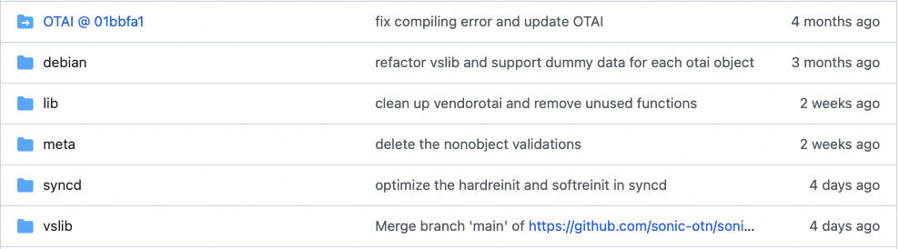
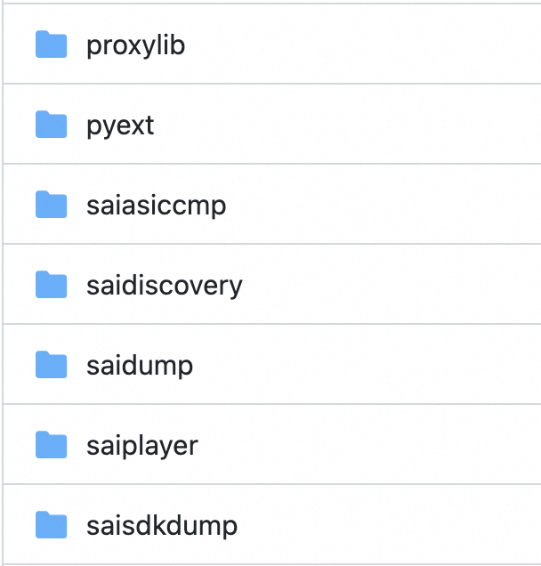
Syncd-ot source code analyze
OTAI submodule
OTAI interface with
meta data validation
OTAI implementation
with optical component simulation
A remote OTAI implementation.
Library for OTSS and Syncd-ot communication
the synchronization of optical components
CRUD request handler and notification handler

Slide 13
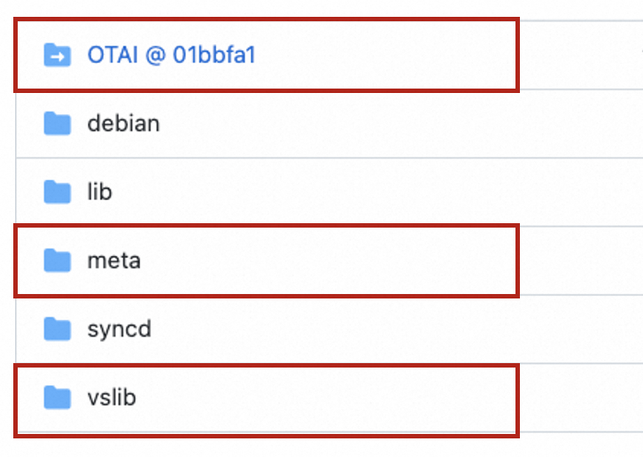
Syncd-ot source code analyze
Meta OTAI interface with meta data validation
Metadata is auto generated based on OTAI definition
Meta OTAI interface involves meta data validations.
Difficult to share SAI/meta source code.
vslib is a pure OTAI implementation with optical component simulation.
OTAI VS
OTAI
Doxygen + Parse.pl
OTAI metadata
OTAI metadata library
OtaiObjectSimulator.cpp
otai*.h
otaimetadata.h
otaimetadata.c
Meta.h
Meta.cpp
Different parameter definitions in SAI and OTAI
sai_object_type_t
sai_object_id_t
sai_attribute_t
……
virtual sai_status_t create(
_In_ sai_object_type_t objectType,
_Out_ sai_object_id_t* objectId,
_In_ sai_object_id_t switchId,
_In_ uint32_t attr_count,
_In_ const sai_attribute_t *attr_list)

Slide 14
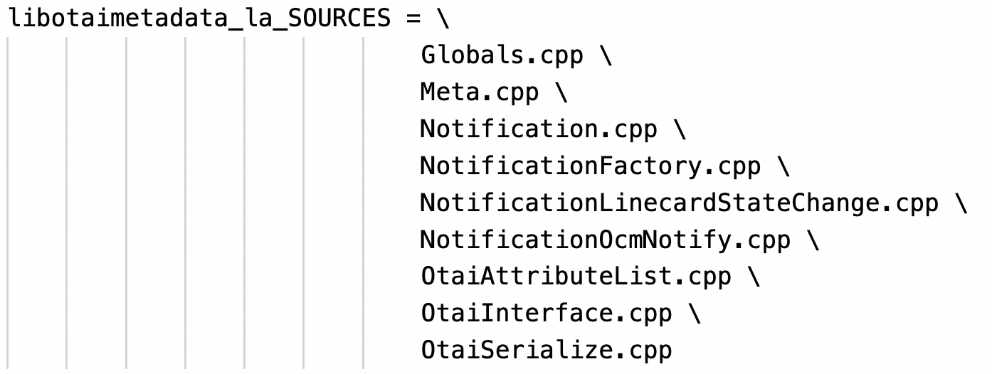
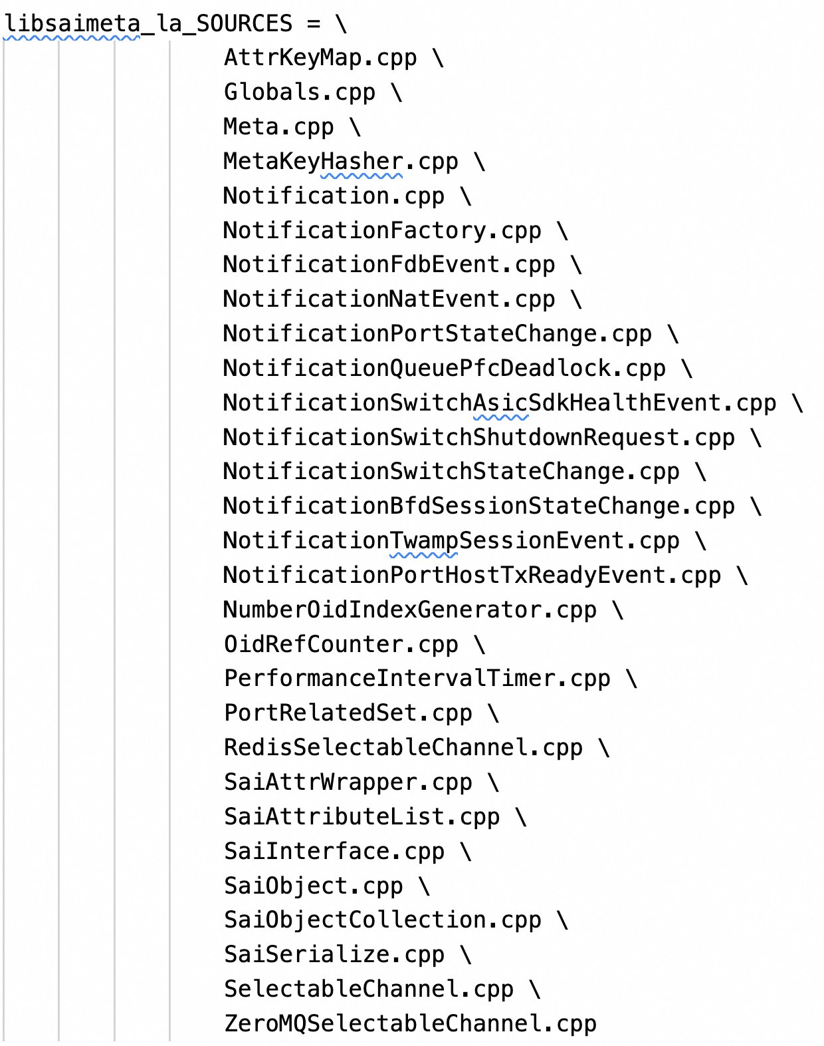
OTAI metadata vs SAI metadata
SAI metadata, 29 files
OTAI metadata, 9 files

Slide 15
OTAI redisLib
Library for OTSS and Syncd-ot communication, Remote OTAI implementation.
Syncd-ot can receive these OTAI CRUD request from OTSS
Syncd-ot can send notifications to OTSS
Publish and subscribe message through Redis Channels
Otairedis library is an implementation of OTAI interface, it cannot share Sairedis library source code.
But the Redis channel APIs are common between Sairedis and Otairedis, Can they move to SWSS_COMMON?

Slide 16
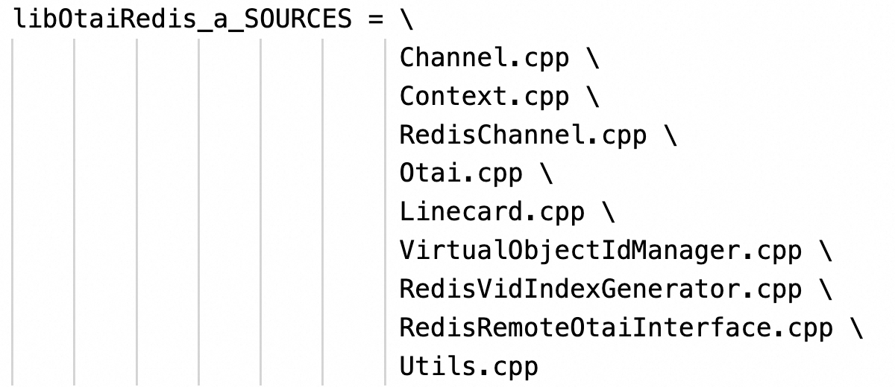
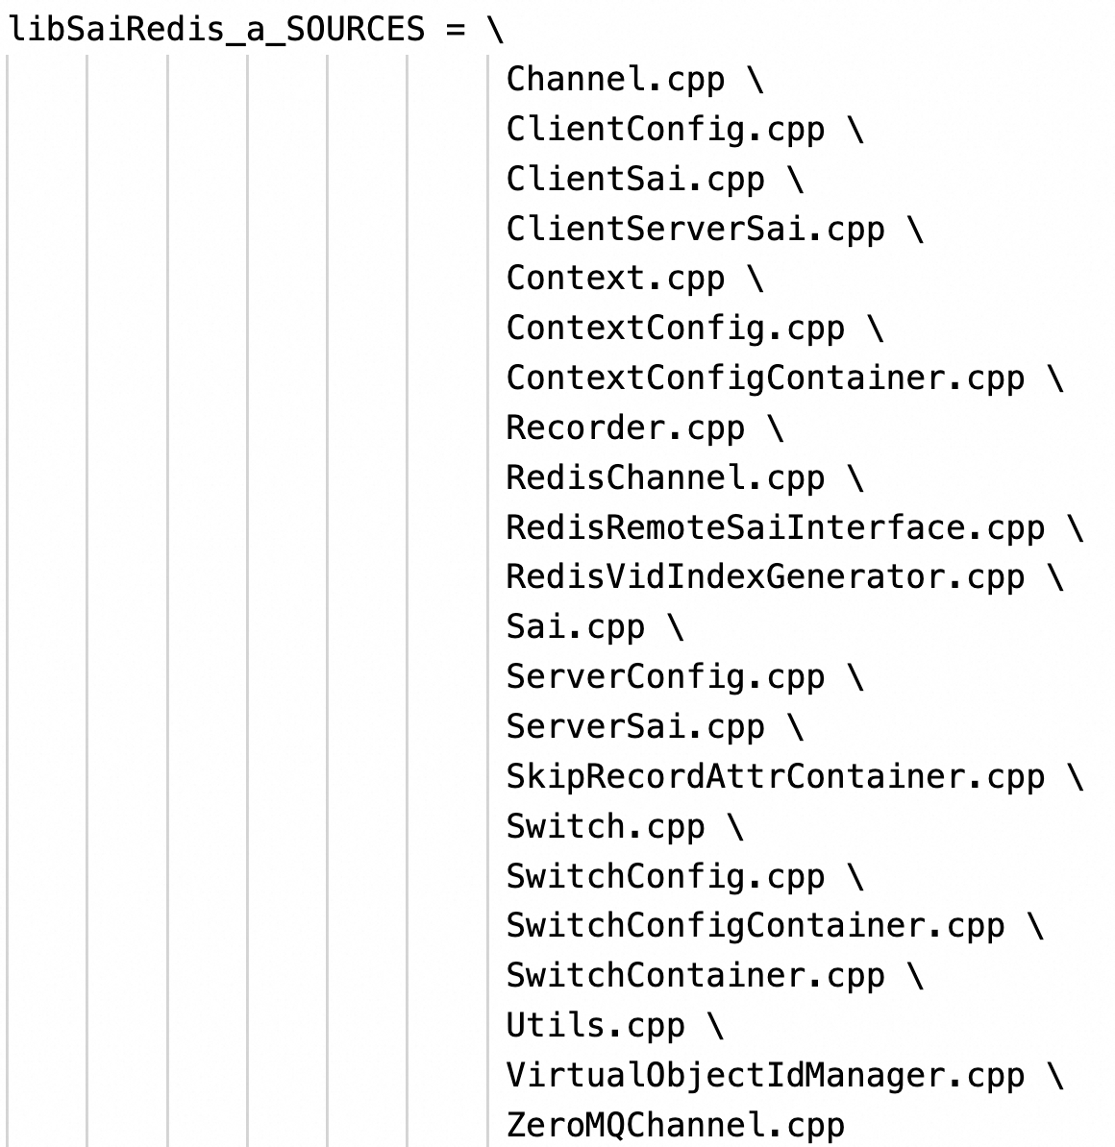
OTAI redisLib vs SAI redisLib
SAI redisLib, 19 files
OTAI redisLib, 6 files
Move 2 files to SWSS_COMMON to share source code
Channel.cpp,
RedisChannel.cpp

Slide 17
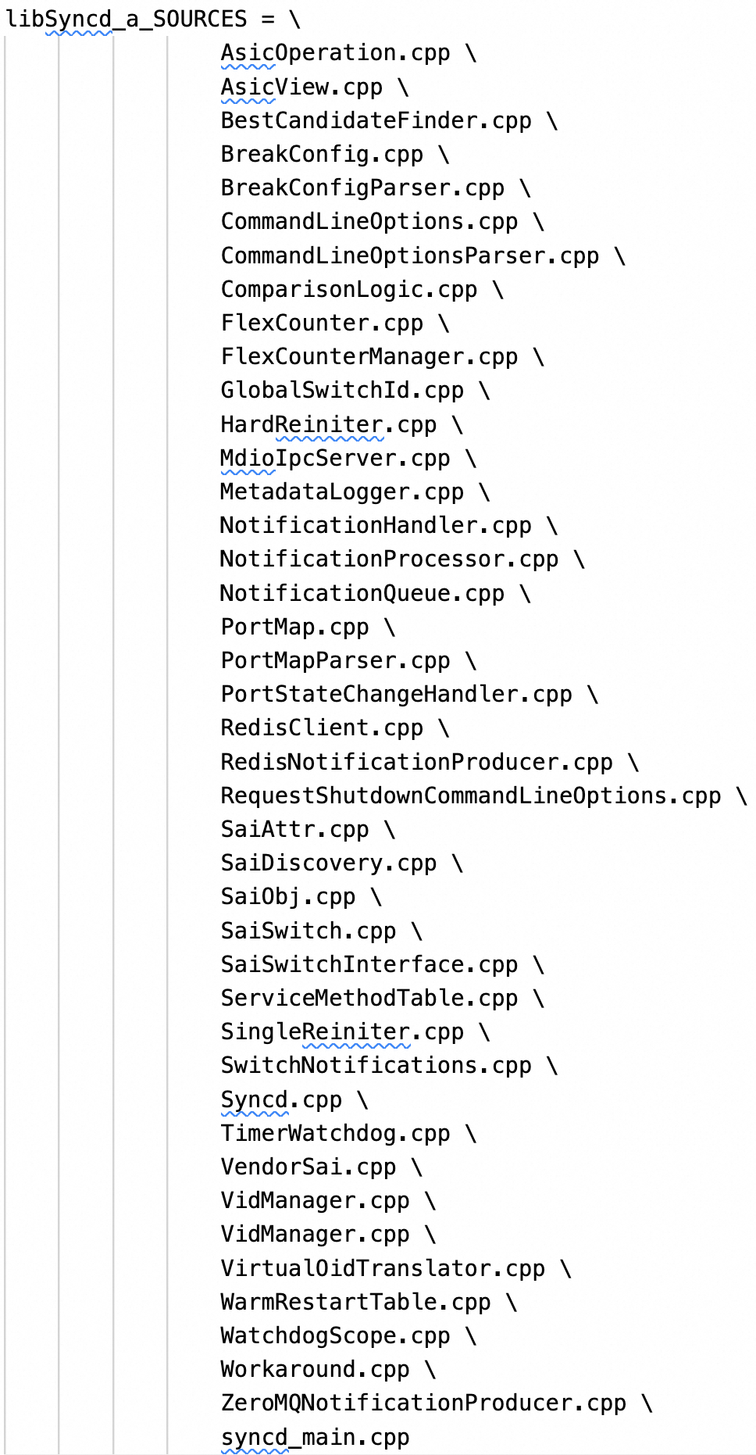
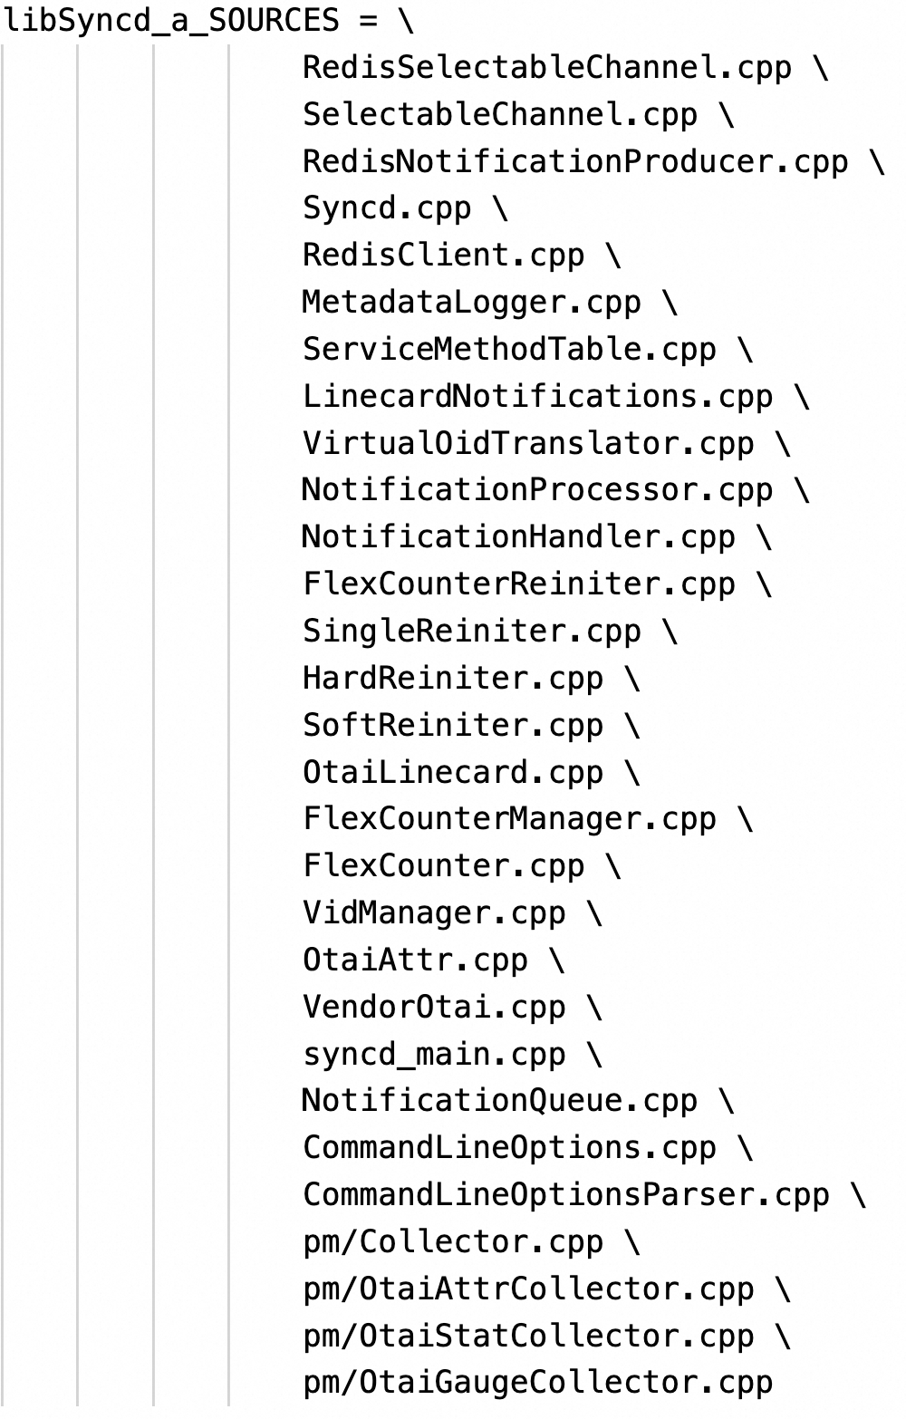
OTAI Syncd vs SAI Syncd
SAI Syncd
40 files
PM module for OTN
OTAI Syncd
25 files
Move 4 files to SWSS_COMMON to share source code
RedisSelectableChannel.cpp,
SelectableChannel.cpp
RedisNotificationProducer.cpp
NotificationQueue.cpp

Slide 18
BACKUP

Slide 19

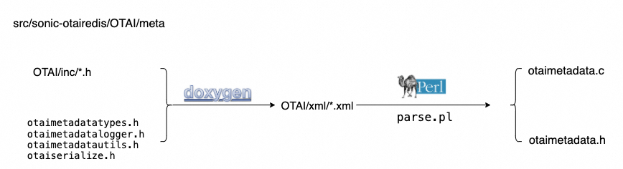
src/otairedis/OTAI/meta
Generate and save OTAI metadata information
Structure metadata
Enums metadata
Union metadata
Notification metadata
Apis metadata
Serializer/ deserializer
Auto generated
+
otaimetadatautils.c
=

Slide 20
const otai_attr_metadata_t* const* const otai_metadata_attr_by_object_type[] = {
……
otai_metadata_object_type_otai_linecard_attr_t,
otai_metadata_object_type_otai_port_attr_t,
……
};
const otai_attr_metadata_t* const otai_metadata_object_type_otai_port_attr_t[] = {
……
&otai_metadata_attr_OTAI_PORT_ATTR_ADMIN_STATE,
……
};
const otai_attr_metadata_t otai_metadata_attr_OTAI_PORT_ATTR_ADMIN_STATE = {
.objecttype = OTAI_OBJECT_TYPE_PORT,
.attrid = OTAI_PORT_ATTR_ADMIN_STATE,
.attridname = "OTAI_PORT_ATTR_ADMIN_STATE",
.flags = (otai_attr_flags_t)(OTAI_ATTR_FLAGS_CREATE_AND_SET),
.enummetadata = &otai_metadata_enum_otai_admin_state_t,
.ismandatoryoncreate = false,
.iscreateonly = false,
.iscreateandset = true,
.isreadonly = false,
……
};
const otai_enum_metadata_t otai_metadata_enum_otai_admin_state_t = {
.name = "otai_admin_state_t",
.valuescount = 3,
.values = (const int*)otai_metadata_otai_admin_state_t_enum_values,
.valuesnames = otai_metadata_otai_admin_state_t_enum_values_names,
};
const otai_stat_metadata_t* const* const otai_metadata_stat_by_object_type[] = {
……
otai_metadata_stat_object_type_otai_port_stat_t,
};
/**
* @brief Port attribute IDs
*/
typedef enum _otai_port_attr_t
{
/**
* @brief Admin state
*
* @type otai_admin_state_t
* @flags CREATE_AND_SET
*/
OTAI_PORT_ATTR_ADMIN_STATE,
}
/**
* @brief Output power
*
* @type otai_double_t
* @unit dBm
* @precision precision2
* @iscounter false
*/
OTAI_PORT_STAT_OUTPUT_POWER,
attribute
statistics

Slide 21

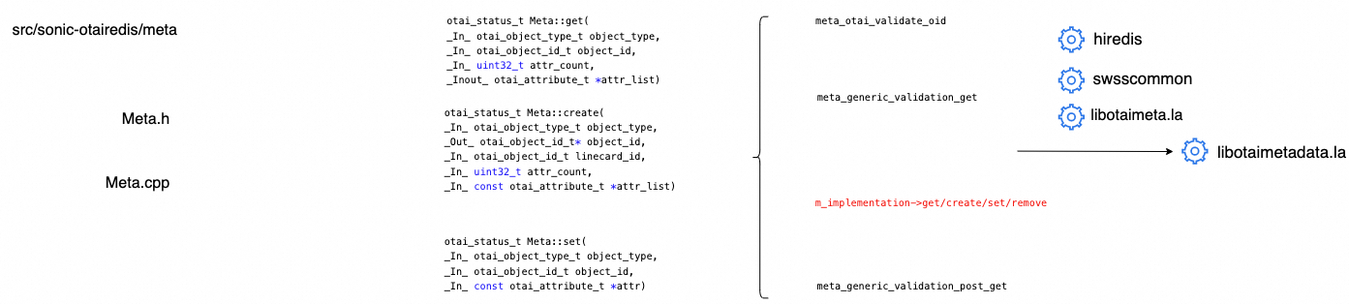
src/otairedis/meta
OTAI API interface with metadata validation.
Validate all the parameters and returned values(OID, attributes, enums
Validate notification data
Validate OTAI objects hierarchy (delete all children objects first)
Implement all OTAI APIs in RedisRemoteOtaiInterface

Slide 22

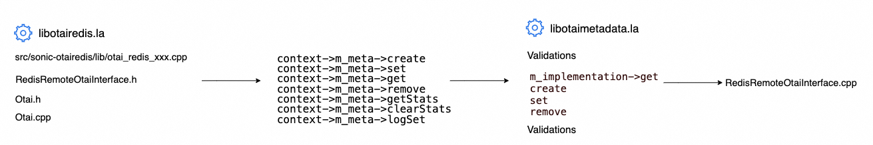
src/otairedis/lib
OTAI API implementation between OTSS and Syncd-OT.
libOtairedis.la implements Otai APIs, Syncd-OT can receive these OTAI CRUD APIs

Slide 23
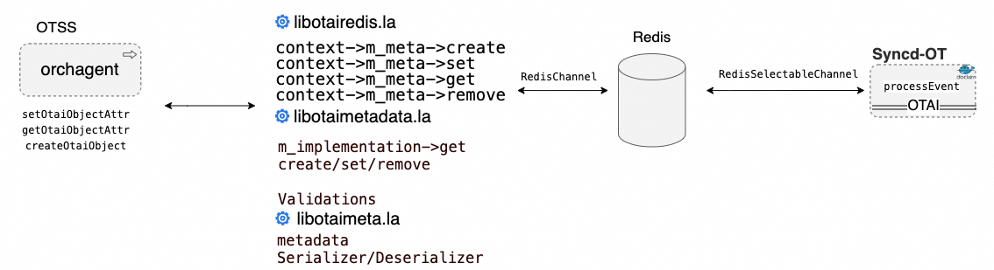
OTSS and Syncd Interactions
OTSS call libotairedis.la to send CRUD requests to Syncd
It involves libotaimetadata.la and libotaimeta.la for metadata validation and serializer/deserializer

Slide 24
Create Functions in Meta
static otai_status_t redis_create_linecard_uniq(
_Out_ otai_object_id_t *linecard_id,
_In_ uint32_t attr_count,
_In_ const otai_attribute_t *attr_list)
typedef int32_t otai_status_t;
typedef uint64_t otai_object_id_t;
typedef struct _otai_attribute_t
{
otai_attr_id_t id;
otai_attribute_value_t value;
} otai_attribute_t;
typedef uint32_t otai_attr_id_t;
typedef union _otai_attribute_value_t
{
/** @validonly meta->attrvaluetype == OTAI_ATTR_VALUE_TYPE_BOOL */
bool booldata;
/** @validonly meta->attrvaluetype == OTAI_ATTR_VALUE_TYPE_CHARDATA */
char chardata[512];
/** @validonly meta->attrvaluetype == OTAI_ATTR_VALUE_TYPE_UINT8 */
otai_uint8_t u8;
……
}
typedef INT32 sai_status_t;
typedef uint64_t sai_object_id_t;

Slide 25
Create Function in Meta
static otai_status_t redis_create_linecard_uniq(
_Out_ otai_object_id_t *linecard_id,
_In_ uint32_t attr_count,
_In_ const otai_attribute_t *attr_list)
auto status = context->m_meta->create(
objectType,
objectId,
linecardId,
attr_count,
attr_list);
Metadata class is type sensitive, and deeply coupled with SAI and OTAI
sai_metadata_all_object_type_infos

Slide 26
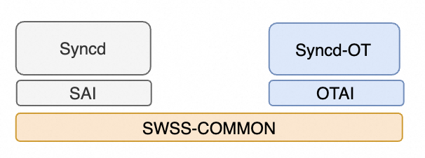
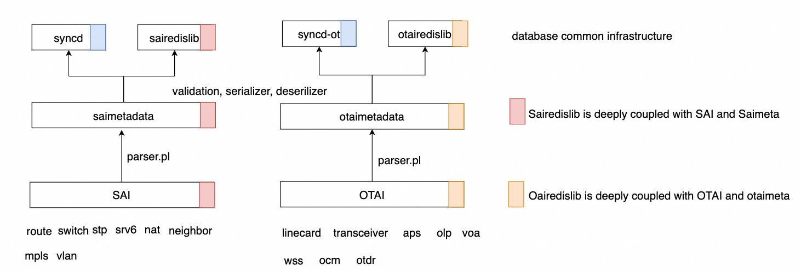

Option1: OTAI and Sai in different repository
Move database common infrastructure to SWSS_COMMON
Two parallel and independent APIs (SAI and OTAI)
Meta/
Lib/
Sai
OTN group maintenance the OTAI APIs and metadata

